Slide 1
Bonjour!
mercredi, le premier mars

Slide 2
Travail de cloche
Write a sentence which is a hypothèse irréel and which speaks about apples.

Slide 3
Bonjour!
mercredi, le premier mars

Slide 4
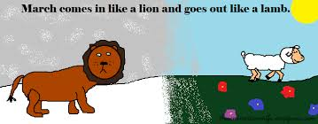
Le mars arrive comme un lion et sort comme un agneau

Slide 5
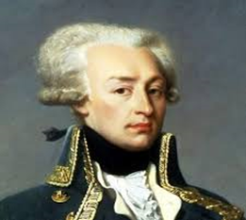
Lafayette was the primary author of the Declaration of the Rights of Man and of the Citizen, which was adopted by the French Revolutionary Assembly in 1789 and which serves as the basic statement of liberty in France to this day.

Slide 6
AVERTISSEMENT
examen, unité 5
vendredi, le trois mars
Vous devrez écrire de La Cigale et La Fourmi.
Vous devrez écrire d’un emploi possible.

Slide 7
une profession

Slide 8
Devoirs

Slide 9
Billet de sortie
Write a sentence in French using the relative pronoun « où » having the meaning of where.

