Slide 1
Bonjour!
lundi, le vingt-sept février

Slide 2
Travail de cloche
Quelle est la profession du vieux MacDonald ?

Slide 3
Bonjour!
lundi, le vingt-sept février

Slide 4
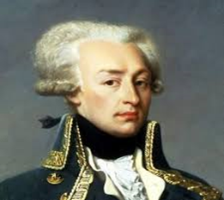
Marie-Joseph Paul Yves Roch Gilbert du Motier, the Marquis de Lafayette, was born into an aristocratic French family in Chavaniac, Auvergne, in 1757.

Slide 5
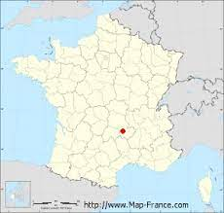

Slide 6
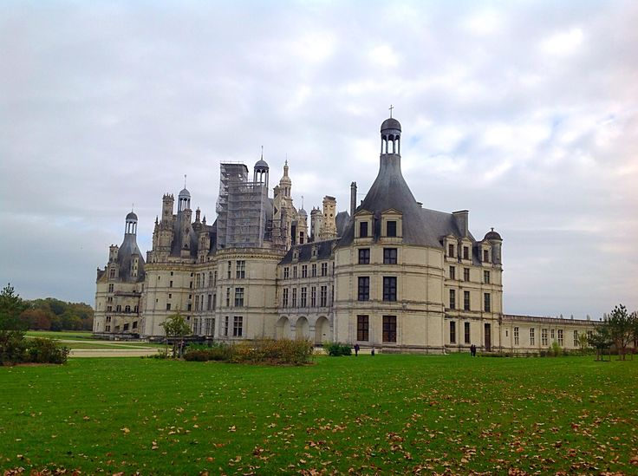

Slide 7
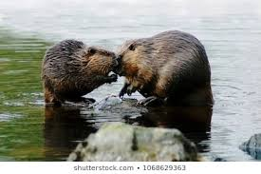
Beavers are monogamous and mate for life.

Slide 8
AVERTISSEMENT
examen, unité 5
vendredi, le trois mars
Vous devrez écrire de La Cigale et La Fourmi.
Vous devrez écrire d’un emploi possible.

Slide 9
Si (present, present)
Si (present, future)
Si (imparfait, conditionnel)

Slide 10
Dès que (present, present)
Quand (present, present)
Dès que (future, future)
Quand (future, future)

Slide 11
Which are your books?
Jennnifer and Maria sang last night. Of which do you speak?
You sold a heater(radiateur) to an ant? To which did you sell it?

Slide 12
Devoirs

Slide 13
Billet de sortie
Write a sentence which uses dont as a relative pronoun.

