Slide 1
Bonjour!
mercredi, le vingt septembre

Slide 2
Travail de cloche
À quelle heure commence la classe de français?

Slide 3
Bonjour!
mercredi, le vingt septembre
un moment de culture francophone
un annonce
les mots de temps

Slide 4
Pourquoi tombons-nous?
Nous tombons pour apprendre comment se lever.

Slide 5
Sommes-nous prêts?
Nous sommes prêts !

Slide 6
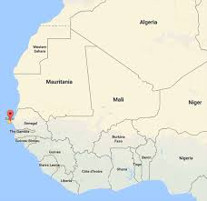
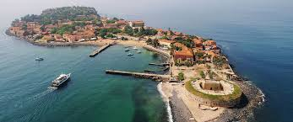
L’Ȋle Gorée, an island to the west of Dakar, Senegal, is a memorial to the victims of the trans-Atlantic slave trade.

Slide 7
Wednesday, September 27, you will give a presentation, completely in French, in class.
The presentation must be about a family member, either real or imaginary.
The presentation must contain five illustrations. They may be made using PowerPoint / Google Slides or be hand drawn. Each illustration must have an appropriate title which explains the slide which shows /tells something about the subject.
The first slide must introduce your subject with a caption such as “C’est ma soeur Ruth” The others must have a heading which tells us something about the person such as “Elle aime les pommes” and an appropriate illustration.
Whether or not you speak about a real person, the photos do not have to be of that person, but they must accurately reflect the statement you make in the caption.

Slide 8
pp. 76 - 77
à l’heure
pile
presque
tard
tôt
vers
en avance
en retard
midi
minuit

Slide 9
pp. 58 - 59
bien sûr
d’accord
mais non
moi / toi non plus
pas de tout
peut-être
pourquoi
parce que

Slide 10
pp. 72 - 73
tu as…
Je crois que tu as _____________ à _____h_________.
J’ai entendu dire que tu as _____________ à _____h_________.
Un espion m’a dit que tu as _____________ à _____h_________.
Il est très important que tu aies ____________ à _____h_________.
L’avenir du monde exige que tu aies ________à ______h_________.
Les capitaines de l’école veulent que tu aies _______à_____h______.
Ma mère t’aimera si tu as __________ à_________h___________.
Je vous donnerai un hippopotame si tu as _______à________h_____.

Slide 11
Devoirs

Slide 12
Billet de sortie
Write a sentence which tells about something you eat every Tuesday.

