Slide 1
Bonjour!
mardi, le vingt-six septembre

Slide 2
Travail de cloche
Explain in English the difference between “ma classe dernière” and “ma dernière classe.”

Slide 3
Bonjour!
mardi, le vingt-six septembre
un moment de culture francophone
un rappel amical
une competition

Slide 4
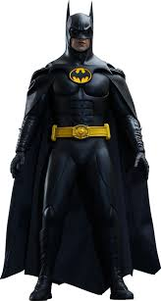
Pourquoi tombons-nous?
Nous tombons pour apprendre comment se lever.

Slide 5
Sommes-nous prêts?
Nous sommes prêts !

Slide 6
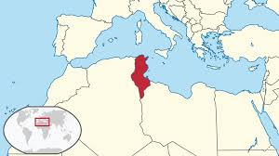
The northern-most point of mainland Africa is in the francophone nation of Tunisia.

Slide 7
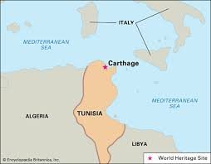

Slide 8
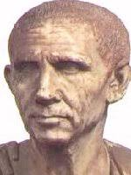
Delenda est Carthago !

Slide 9

Cato the Censor

Slide 10
Un rappel amical
Tomorrow! Wednesday, September 27, you will give a presentation, completely in French, in class.
The presentation must be about a family member, either real or imaginary.
The presentation must contain five illustrations. They may be made using PowerPoint / Google Slides or be hand drawn. Each illustration must have an appropriate title which explains the slide which shows /tells something about the subject.
The first must introduce your subject with a caption such as “C’est ma soeur Ruth” The others must have a heading which tells us something about the person such as “Elle aime les pommes” and an appropriate illustration.
Whether or not you speak about a real person, the photos do not have to be of that person, but they must accurately reflect the statement you make in the caption.
If your presentation needs to be projected, please send a copy of you file to M. Gerson before 7:45 AM Wednesday.

Slide 11

Line up according to size place.
Lisez “Panorama: La France” pp. 82 – 83.
Write out five questions which you can ask the other team. The answers to the questions must be found on pp. 82 – 83.

Slide 12
Devoirs
Complete your presentation

Slide 13
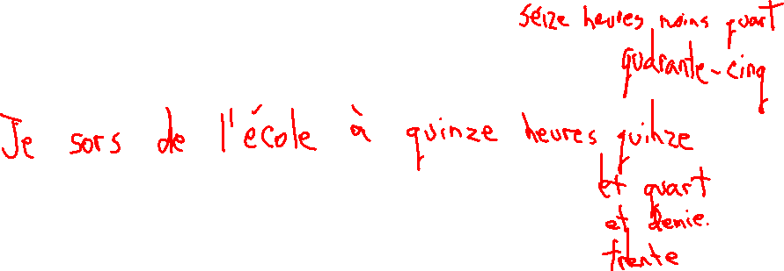
Billet de sortie
Write a complete sentence in French which tells at what time you leave school, using twenty-four hour time, with words.

