Slide 1
vendredi, le vingt-neuf septembre

Slide 2
Travail de cloche
Write three sentences in French which tell how you need three different things for three different classes which you are currently taking.

Slide 3
vendredi, le vingt-neuf septembre

Slide 4
Vendredi, vendredi
Rah, rah, rah!
Vendredi, vendredi
On y va!

Slide 5
vendredi, le vingt-neuf septembre
avertissement
un moment du culture francophone
révisons!

Slide 6
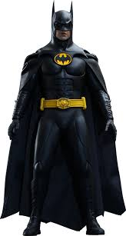
Pourquoi tombons-nous?
Nous tombons pour apprendre comment se lever.

Slide 7
Sommes-nous prêts?
Nous sommes prêts !

Slide 8
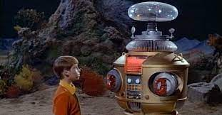
AVERTISSEMENT!
Exam: Unit 2
Friday, October 6
“ER” verbs, avoir, avoir idioms, telling time, vocabulary p. 88

Slide 9
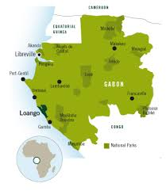
Loango Park, in the francophone country Gabon, is home to such diverse animals as gorillas, hippopotamuses, and whales

Slide 10
List six courses which are taught at a school. Be certain to use a proper definite article.

Slide 11
Write a sentence in French which in some way discusses school and / or your classes using the pronouns indicated and adding at least four words to the subject. Each sentence must use a different regular “ER” verb.
Je
Tu
Elle
Nous
Vous
Ils

Slide 12
Use the dictionary to look up the French words for three animals which you might find in Loango Park.
Write three sentences, each of which uses an expression with avoir, one of the animals which you have chosen, and a regular “ER” verb from p. 54. Use the dictionary to find words you do not know.
Speak to three classmates. For each one write what one of them said about a specific animal. You must get sentences which mention three different animals.

Slide 13
Devoirs

Slide 14
Write a sentence which uses the verb partager and the subject “My mother and I.”

