Slide 1
Bonjour!
lundi, le vingt novembre

Slide 2
Travail de cloche
Write a sentence which uses le conditionnel to provide speculation.

Slide 3
Bonjour!
lundi, le vingt novembre

Slide 4
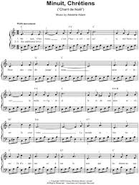
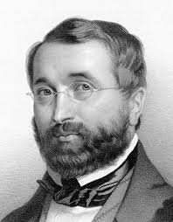
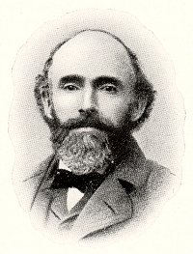
Minuit Chrétiens, whose music was written by the French composer Adolphe Adam, setting the words of a French poem by Placide Cappeau, is known in the anglosphere as O, Holy Night.

Slide 5
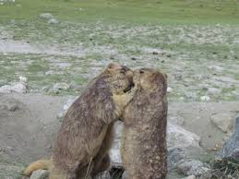
Vendredi était l’anniversaire doré du mariage de Justin et Céline. Anniversaire doré = married fifty years.

Slide 6
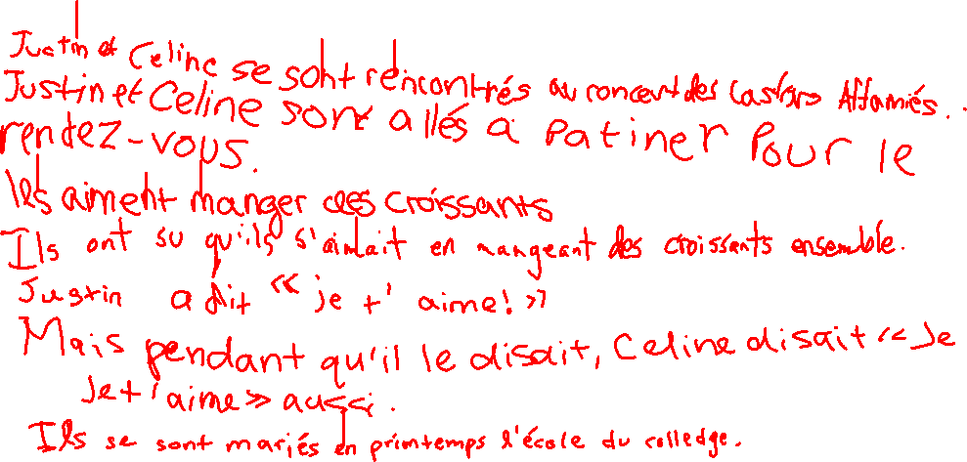
We will now tell the story of the wonderful fifty year marriage of Justin and Celine, including how they met, how they knew when they were in love, what their wedding was like, what have been the major events of their fifty years of marriage, what they look forward to for the future.

Slide 7
Devoirs

Slide 8
Billet de sortie
Écrivez une hypothèse irréelle that relates to the story of Justin and Celine.

