Slide 1
Bonjour!
mardi, le vingt et un novembre

Slide 2
Travail de cloche
Write a sentence of at least five words which uses the verb aller in
le conditionnel.

Slide 3
Bonjour!
mardi, le vingt et un novembre
un moment de culture francophone
verbs with irregular stems in the conditional

Slide 4
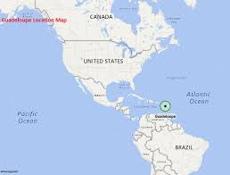
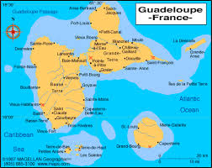
Guadeloupe was a territory of Spain, France, England, and Sweden before 1816. It has been continuously French since that time.

Slide 5
The presentation on visiting a francophone city will be postponed until after M. Gerson returns in January.
Unit 3 exam: Friday, December 8
Final Exam (cumulative) Thursday, December 14: 12:10 – 1:50 PM

Slide 6
Verbs with irregular stems in le conditionnel.
aller envoyer recevoir
apercevoir être savoir
avoir faire venir
devoir pouvoir vouloir

Slide 7
Devoirs

Slide 8
Billet de sortie
Quand Justin et Céline se parlent aujourd’hui, quel est le sujet?

