Slide 1
Bonjour!
vendredi, le vingt-deux mars

Slide 2
Travail de cloche
Translate into French: I will happily begin the week-end today.
Notes:
é

Slide 3
Bonjour!
vendredi, le vingt-deux mars

Slide 4
Vendredi, vendredi
Rah, rah, rah!
Vendredi, vendredi
On y va!

Slide 5
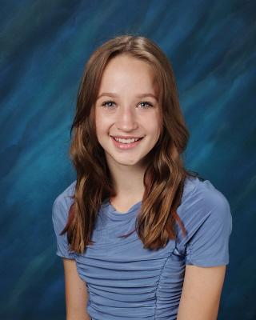
Bon anniversaire (demain)
Bon anniversaire (demain)
Bon anniversaire (demain)
Bon anniversaire (demain) chère Kate
Bon anniversaire (demain)

Slide 6
Bonjour!
vendredi, le vingt-deux mars
un moment de culture francophone
révision
un conte de fée
The students will tell the story of a beloved character.

Slide 7
Pourquoi tombons-nous?
Nous tombons pour apprendre comment se lever.

Slide 8
Sommes-nous prêts?
Nous sommes prêts !

Slide 9
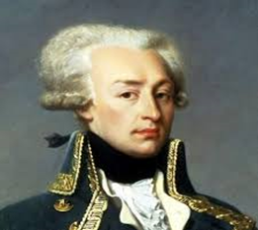
When the first American troops arrived in France to fight during World War I, Col. Charles Stanton tried to say in French “Lafayette, we are here!” but actually spouted ungrammatical gibberish.

Slide 10
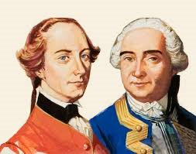
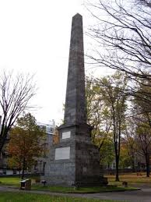
Both the British commander Wolfe and the French commander Montcalm died at the battle of the Plains of Abraham. A monument in honor of both men in Quebec says: “Mortem virtus communem; faman historia; monumentum posteritas dedit”

Slide 11
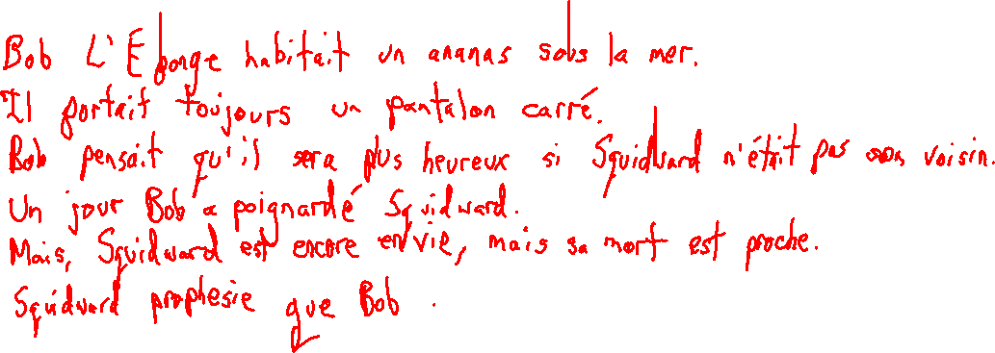
Il était une fois un éponge qui s’appelait Bob.

Slide 12
Yesterday, at 7 PM, Jacques and Pierre sang La Marseillaise.
I was playing football and I fell.
I was reading when suddenly the bell rang.
You (familiar) climbed the hill (la colline) to your home after school.
Charlotte was born in France.
We entered the school.

Slide 13
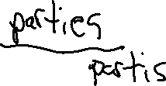
Le passé compsosé avec être
devenir naÎtre je
revenir descendre tu
monter entrer elle
sortir retourner nous
venir tomber vous
arriver rester ils
aller mourir
partir passer
rentrer

Slide 14
Devoirs

Slide 15
Billet de sortie
Translate into French: Justin arrived in Paris on Monday. Justin and Pierre went to the Louvre Museum on Tuesday. Justin and I fell into the Seine on Wednesday. You and Justin departed for the United States on Thursday.
Notes:
é

