Slide 1
Bonjour!
lundi, le vingt-cinq mars

Slide 2
Travail de cloche
Translate into French: Jean is happy that Jeanne has more lobsters than Elisabeth but he doubts that Sophie and Augusta have fewer hippopotamuses than William .

Slide 3
Bonjour!
lundi, le vingt-cinq mars

Slide 4
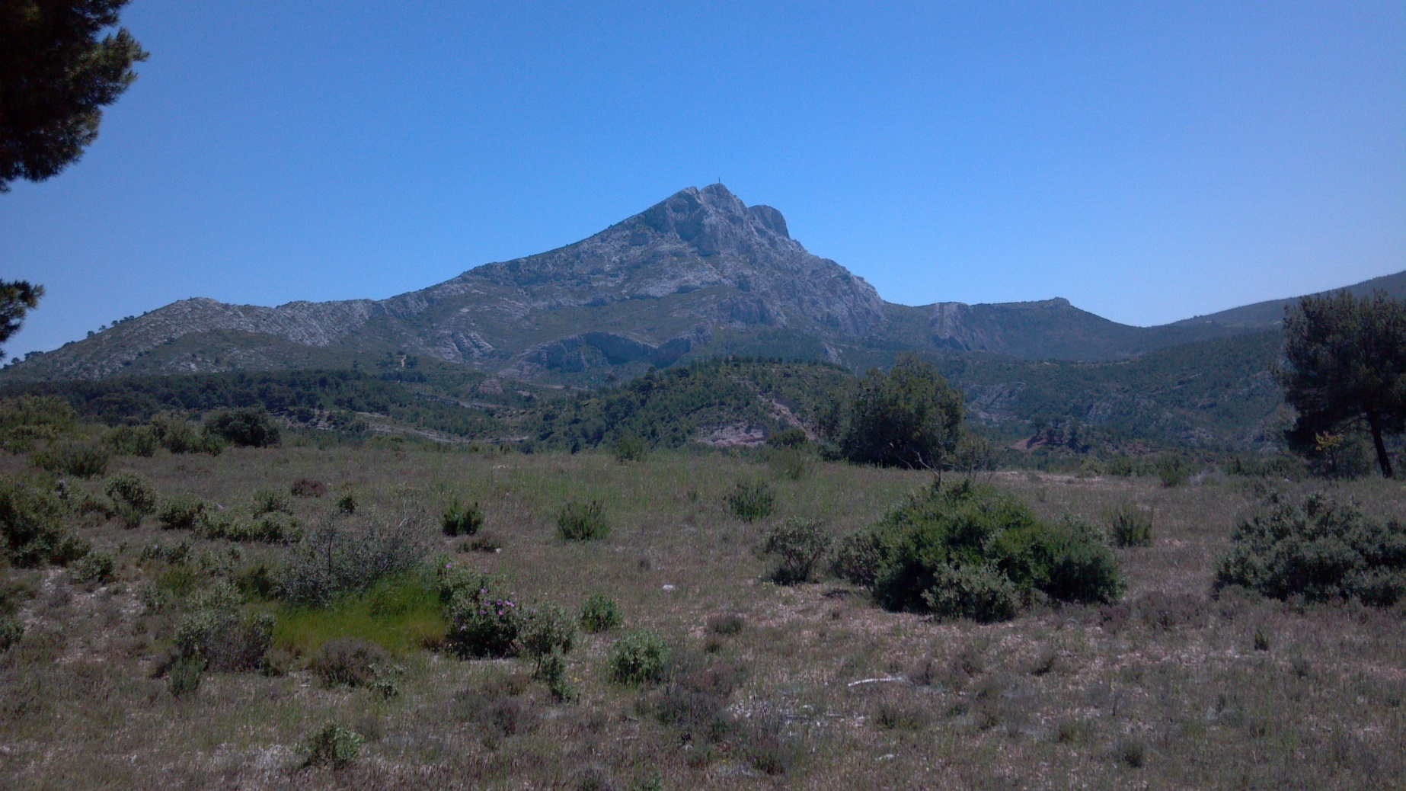
Sainte-Victoire

Slide 5
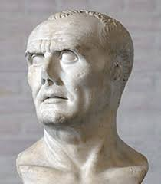
La Bataille d’Aquae Sextiae 102 BC

Slide 6
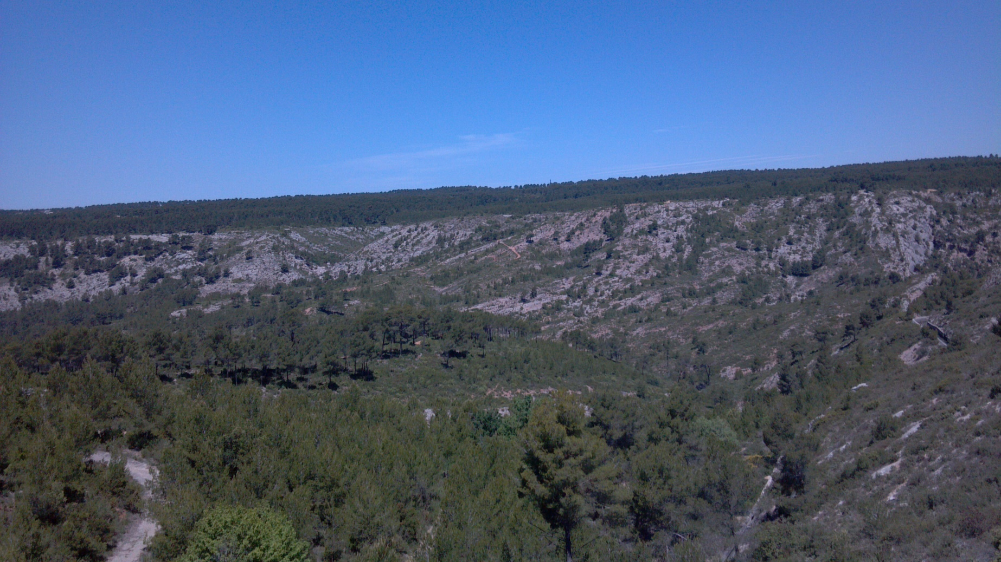
les causes

Slide 7
I have more soup than Bob.
les pronoms disjoints

Slide 8
I have more soup than Bob.
les pronoms disjoints
moi nous
toi vous
lui eux
elle elles

Slide 9
Basil a plus de cheveux que moi.

Slide 10
Speak to three other people in the class.
Find out how many of something the other person has.
Write a series of sentence in the form: I have three pens. Alice has one pen. I have more pens than Alice.
Find things where you can say “I have more ____ than A”
“I have less ____ than B”
“I have as many ____ as C”

Slide 11
Devoirs

Slide 12
Billet de sortie
Write a sentence about the coming week which uses the subjunctive but which does not use the expressions “I am sad” or “I am happy.”

