Slide 1
Bonjour!
mardi, le vingt-six mars

Slide 2
Travail de cloche
Translate into French: Even though he is tall, Jacques can not play basketball.

Slide 3
Bonjour!
mardi, le vingt-six mars

Slide 4
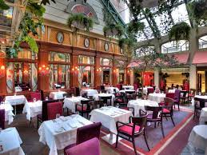
Selon M. Gerson, Le Saint-Amour est le meilleur restaurant à Québec.

Slide 5
I have more soup than Bob.
les pronoms disjoints

Slide 6
I have more soup than Bob.
les pronoms disjoints
moi nous
toi vous
lui eux
elle elles

Slide 7
Basil a plus de cheveux que moi.

Slide 8
Speak to three other people in the class.
Find out how many of something the other person has.
Write a series of sentence in the form: I have three pens. Alice has one pen. I have more pens than Alice.
Find things where you can say “I have more ____ than A”
“I have less ____ than B”
“I have as many ____ as C”

Slide 9
la croyance
le doute

Slide 10
They doubt that you (familiar) read books like Moby Dick.
We do not think that Imogen has Edwyn’s book.
My dog has more fleas (puce f) than Juno.
This band has fewer musicians than the Fort Collins Symphony.

Slide 11
Jacques has as many horses as Laurent.
I wish you a Merry Christmas.
John and Robert are astonished that you do the cooking at your house.
Your (familiar) house (domus) earned more points for the Neenan Cup than DK.

Slide 12
Verbs and expressions of emotion or feeling - fear, happiness, anger, regret, surprise, or any other sentiments - require the subjunctive.
Bob et Carol sont tristes que Ted et Alice soient malades.
Nous sommes heureuses que Les Castors Affamés fassent leurs devoirs.
Robert est content que j’aie la plus belle vache du monde.

Slide 13
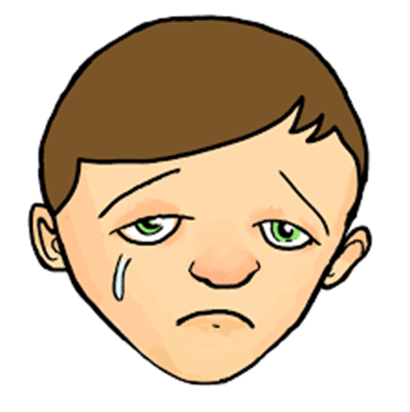

Slide 14
Devoirs

Slide 15
Billet de sortie
Translate into French: I believe that Justin will buy a fish at lunch today. I doubt that Claude will come to the party.

