Slide 1
Bonjour!
jeudi, le vingt-huit mars

Slide 2
Travail de cloche
Write a sentence in French which uses the conjunctive phrase “a moins que” and the which uses the subjunctive.

Slide 3
Bonjour!
jeudi, le vingt-huit mars

Slide 4
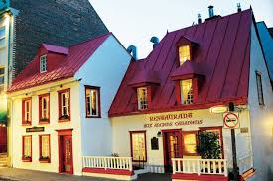
The restaurant “Aux Anciens Canadiens” in Quebec city is housed in a building which was built in 1665.

Slide 5
AVERTISSEMENT!
Examen
Unité 6
Friday, April 5

Slide 6
Jacques has as many horses as Laurent.
I wish you a Merry Christmas.
John and Robert are astonished that you do the cooking at your house.
Your (familiar) house (domus) earned more points for the Neenan Cup than DF.

Slide 7
Slytherin was celebrating their Neenan Cup victory when suddenly Dumbledore changed the rules and awarded points to Gryffindor which no other house could earn.
Draco was furious that Slytherin was celebrating their Neenan Cup when suddenly Dumbledore changed the rules and awarded points to Gryffindor which no other house could earn.

Slide 8
Arthur does not think that Imogen has Edwyn’s book.
My dog has more fleas (puce f) than Juno.
This band has fewer musicians than the Fort Collins Symphony.

Slide 9
aérobique alphabet

Slide 10
la musique
Flower Duet
Lakmé

Slide 11
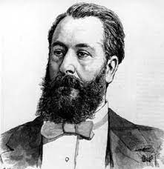
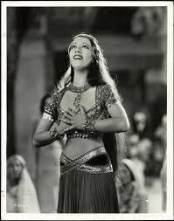
Léo Délibes
Lily Pons

Slide 12
On parle français!!!

Slide 13
Une phrase d’encouragement.
Écrivez trois phrases qui décrivent votre philosophie de la vie.
Écrivez une phrase qui commence “Je doute que…”
Écrivez une autre qui commence “Je ne crois pas que…”
Écrivez un autre qui commence “Je suis heureu(x)(se) que…”

Slide 14
Devoirs

Slide 15
Billet de sortie
Translate into French: In order to help the school, I do my duty as a hall monitor during PSAT testing.

