Slide 1
mercredi, le dix-sept avril

Slide 2
Travail de cloche
Écrivez une phrase qui parle de d’une actualité qui vous interesse.

Slide 3
mercredi, le dix-sept avril

Slide 4
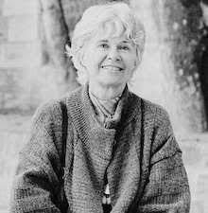
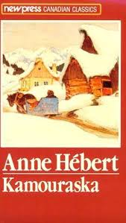
Anne Hébert is a francophone Quebecoise author who is best known for her book Kamouraska, which is based on the true events surrounding a XIX century murder in Quebec.

Slide 5
les personnages du roman-photo
en l’an 2044

Slide 6
You (familiar) have to wait for Justin, who will arrive at 2:30 this afternoon. (Begin sentence with Il faut)
You (formal) want Marguerite to finish the book.

Slide 7
I do not know anyone who makes a good apple pie.
There is nothing that could help me.
One must study to learn Spanish. (Begin sentence with Il faut)
I must practice to play the piano well. (Begin sentence with Il faut)

Slide 8
Devoirs

Slide 9
Billet de sortie
Quel est votre grand espoir pour le dîner aujourd’hui?

