Slide 1
Bonjour!
lundi, le six mai

Slide 2
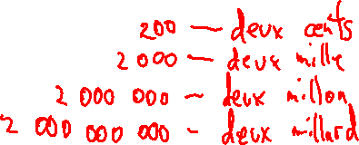
Travail de cloche
Write the French word for the number shown. A complete sentence is not required.
1.000.000.000

Slide 3
Bonjour!
lundi, le six mai
un moment de culture francophone
Marc et Julie

Slide 4
Pourquoi tombons-nous?
Nous tombons pour apprendre comment se lever.

Slide 5
Sommes-nous prêts?
Nous sommes prêts !

Slide 6
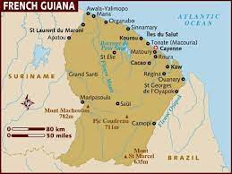
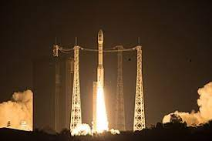
The European Union Space Center is located at Kourou, in French Guyana

Slide 7
Final Exam: Cumulative for Semester 2: Tuesday, May 21, 12:10 – 1:50
If you wish to go to another classroom after you finish the final exam, you must have a pass from another teacher before the test begins: i.e. you may not leave 205A to go to ask another teacher for a pass.
You are encouraged to bring material for study for another class or casual reading in the event that you complete the exam before the end of the period. Quiet will be enforced even after all exam papers have been handed-in.
You are welcome to attend quiet study hall Tuesday and Wednesday 2:00 – 2:45 in Room 205A.

Slide 8
Qui est Marc?
Qui est Julie?
Quel est le nom de Marc?
Quel es le nom de Julie?
Comment s’appelle le chien de Julie?

Slide 9
I know where Justin sings.
You (familiar) know Tom.
They know the words (paroles) to La Belle et La Bête.
We know Loveland, and we love it.
You and Becky know how to make cookies.

Slide 10
Jacques a donné trois croissants à Brigitte et à moi.
Les sœurs envoient une lettre à leur mère.
Justin veut donner un livre à ses cousins.
Je vais raconter une histoire à ton chien et à toi.

Slide 11
attendre: to wait (for)
défendre: to defend
descendre: to descend
entendre: to hear
étendre: to stretch
fondre: to melt
pendre: to hang, suspend
perdre: to lose
prétendre: to claim
rendre: to give back, return
répandre: to spread, scatter
répondre: to answer
vendre: to sell

Slide 12
descendre (regular RE) prendre (irregular RE)
je descends je prends
tu descends tu prends
il descend il prend
nous descendons nous prenons
vous descendez vous prenez
ils descendent elles prennent
past participle descendu pris

Slide 13
Write a sentence of at least five words using a regular « RE » verb in the mode indicated.
(passé compose)
(imparfait)
(futur proche)

Slide 14
Devoirs

Slide 15
Billet de sortie
Write the number shown below in French words. A complete sentence is not required.
1.123.172

