Slide 1
Bonjour!
lundi, le treize mai

Slide 2
Travail de cloche
Change the sentence below so that a proper pronoun is substituted for the COD and COI.
Jacques a donné trois croissants à Brigitte et moi.

Slide 3
Bonjour!
lundi, le treize mai
un moment de culture francophone
La Reconsiliation
la révision

Slide 4
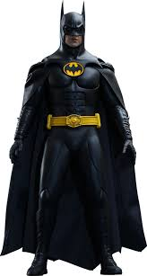
Pourquoi tombons-nous?
Nous tombons pour apprendre comment se lever.

Slide 5
Sommes-nous prêts?
Nous sommes prêts !

Slide 6
This Week !!!
TODAY: Monday, May 13: Instrumental and Vocal Music concert. CSU Performing Arts Center: 6:30 PM
Thursday, May 16: Awards Ceremony: Colosseum: 6:30 PM
Friday, May 17: Eagle Games. No classes

Slide 7
French Polynesia is divided into five groups of islands: the Society Islands (comprising the Windward Islands and the Leeward Islands) the Tuamotu Archipelago; the Gambier Islands; the Marquesas Islands; and the Austral Islands.

Slide 8
Quiz: Marc et Julie
Monday, May 20
20 minutes

Slide 9
La Reconciliation
pp. 46 - 47

Slide 10
I know where Justin sings.
You (familiar) know Tom.
Anne knows the words (paroles) to La Belle et la bête.
We know Loveland, and we love it.
You and Becky know how to make cookies.

Slide 11
Devoirs

Slide 12
Billet de sortie
Translate into French: George Washington was born in February.

