Slide 1
Bonjour!
mardi, le quinze octobre

Slide 2
Travail de cloche
Se laver (to wash oneself) is a reflexive verb. Translate into French: They wash their face.

Slide 3
Bonjour!
mardi, le quinze octobre

Slide 4
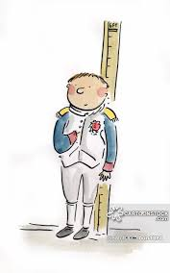
Despite two centuries of jokes about him being short, Napoléon Bonaparte was 5’7” tall, which made him taller than the average French man of his era.

Slide 5
le corps

Slide 6
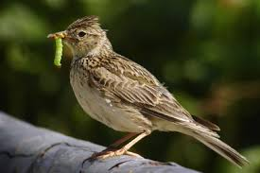
alouette

Slide 7
Alouette, gentille alouette
Alouette, je te plumerai
Je te plumerai la tête
Je te plumerai la tête
Et la tête
Et la tête
Alouette
Alouette
Oh, oh, oh, oh
Alouette, gentille alouette
Alouette, je te plumerai

Slide 8
Jacques a dit…
tapez levez mettez secouez tapotez
sur dessus dessous autour

Slide 9
Devoirs

Slide 10
Billet de sortie
Translate into French. We wash our hair and they wash their horses.

