Slide 1
Bonjour!
jeudi, le dix-sept octobre

Slide 2
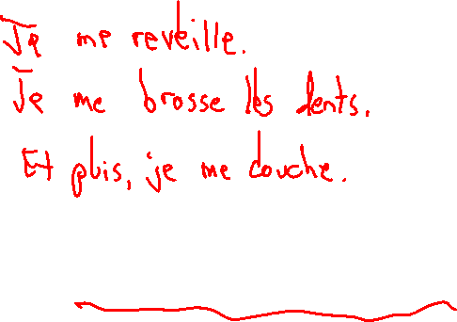
Travail de cloche
Write three sentences, each of which uses a different reflexive verb, to tell about things you do every morning.

Slide 3
Bonjour!
jeudi, le dix-sept octobre

Slide 4
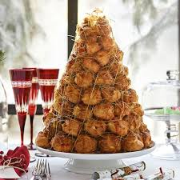
The croquembouche is the traditional French wedding cake.

Slide 5
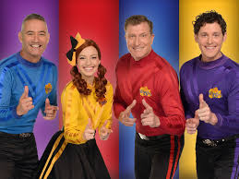
une chanson!

Slide 6
Charlemagne

Slide 7
aérobique alphabet

Slide 8
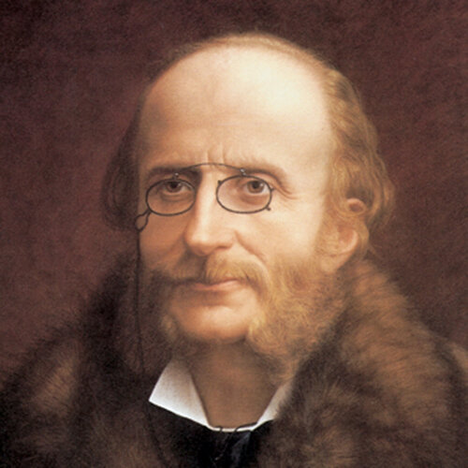

Slide 9
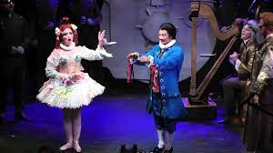

Slide 10
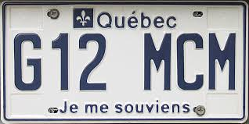
pp. 128 - 129

Slide 12
pp. 128 - 129
Je
Tu
Elle
Nous
Vous
Ils

Slide 13
Write a sentence using the reflexive verb which you have chosen. Your sentence must give information beyond simply using the verb.
e.g. Unacceptable: Justin se met en colère.
Acceptable: Justin se met en colère quand il ne peut pas trouver du bois pour son barrage.
Write your name after your sentence
Place yourwork on a desk along the exterior of the room
View all of the other sentences which have been written. Choose the sentence which you find most compelling, and be ready to explain why you have chosen it.

Slide 14
Je me réveille à sept heures.
Je me douche à dix-sept heures.
Je me couche à vingt-trois heures.
Write three sentences such as those above: each using a different reflexive verb, each telling when you do something. Use twenty-four hour time to tell when you do each thing. Have one done in the morning, one in the afternoon, one in the evening.
Look at the work of the other students and write when three different people do something. Write in the form « X se réveille à sept heures. » Have one example from the morning, one from the afternoon, and one from the evening.

Slide 15
Devoirs

Slide 16
Billet de sortie
Pourquoi est Charlemagne bien connu?

