Slide 1
Bonjour!
mercredi, le vingt-trois octobre

Slide 2
Travail de cloche
Write a sentence which describes the person sitting to your left and the person sitting to your right. Your description must use the French words for “to the right” and “to the left.”
THERE ARE PEOPLE TO YOUR RIGHT AND TO YOUR LEFT, WHETHER OR NOT YOU CAN EASILY SEE THEM!

Slide 3
Bonjour!
mercredi, le vingt-trois octobre
un moment de culture francophone
la révision
les adjectifs possessifs / les adjectifs descriptifs

Slide 4
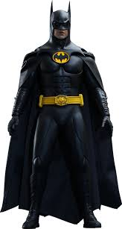
Pourquoi tombons-nous?
Nous tombons pour apprendre comment se lever.

Slide 5
Sommes-nous prêts?
Nous sommes prêts !

Slide 6
Paul van Haver, known as Stromae, is a « rap » singer who was born in Brussels to a Rwandan father and a Belgian mother.

Slide 7
pp. 108 - 109 un croquembouche

Slide 8
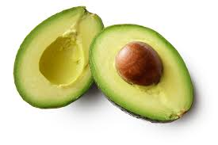

Slide 9
un médecin

Slide 10
une médecine

Slide 11
(Proper noun) is a (profession). (S)he is (adjective) and (s)he she is (preposition) (proper noun) who is a(n) (adjective) (profession).

Slide 12
Devoirs

Slide 13
Billet de sortie
Translate into French: The little spider is between two elephants. She is scared.

