Slide 1
Bonjour!
lundi, le quatre novembre

Slide 2
Travail de cloche
Write a sentence which uses le futur proche.

Slide 3
Bonjour!
lundi, le quatre novembre
un moment de culture américain
où on va?
le théâtre
la musique

Slide 4
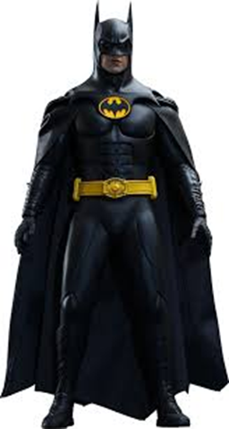
Pourquoi tombons-nous?
Nous tombons pour apprendre comment se lever.

Slide 5
Sommes-nous prêts?
Nous sommes prêts !

Slide 6
Next unit exam: Friday, November 8

Slide 7
Whenever I find myself growing grim about the mouth; whenever it is a damp, drizzly November in my soul; whenever I find myself involuntarily pausing before coffin warehouses, and bringing up the rear of every funeral I meet; and especially whenever my hypos get such an upper hand of me, that it requires a strong moral principle to prevent me from deliberately stepping into the street, and methodically knocking people’s hats off—then, I account it high time to get to sea as soon as I can.

Slide 8
aller
to go
je vais nous allons
tu vas vous allez
il va ils vont
elle va elles vont

Slide 9
My pens are under the table.
Your (familiar) calculator is to the right of the pencil.
His banana is at my home.
Our notebooks are along-side of the map.
Your (formal) cousins (feminine) are beautiful.
The fountain-pen of my aunt is on the desk of my uncle.

Slide 10
19 + 42 =
18 x 4 =
93 - 14 =
48 ÷ 4 =
√64 =
∛(27 ) =

Slide 11
Write five sentences in French each using
a different occupation / profession as the subject
a different adjective to describe that person.
a different preposition and a different disjunctive pronoun to describe where the person is.

Slide 12
Devoirs

Slide 13
Billet de sortie
Write a sentence which tells about someplace you go on a regular basis.

