Slide 1
Bonjour!
mercredi, le six novembre

Slide 2
Travail de cloche
Qui est un médecin qui est complètement fictif?

Slide 3
Bonjour!
mercredi, le six novembre
un moment de culture francophone
révision

Slide 4
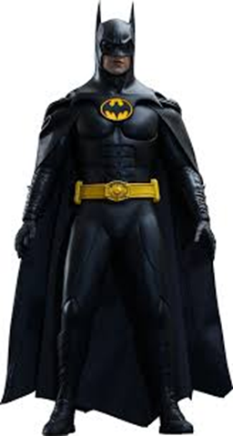
Pourquoi tombons-nous?
Nous tombons pour apprendre comment se lever.

Slide 5
Sommes-nous prêts?
Nous sommes prêts !

Slide 6
The Swiss do not eat fondue during the summer

Slide 7
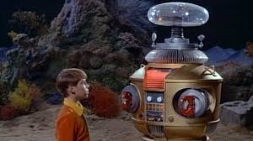
Avertissement! Avertissement! Il y a du danger, Will Robinson!

Slide 8
Next unit exam: Friday, November 8

Slide 9
Write a sentence which uses le futur proche.
If you have not already done so, add to your sentence to tell where your futur proche action will take place.
Use a preposition to describe where the location above is, relative to someplace else.
Go to the board and write there what you have written on your paper. Write your name along with your telling what you will do and where.

Slide 10
Devoirs

Slide 11
Billet de sortie
Write a sentence which tells what you will do when this class ends.

