Slide 1
Bonjour!
mercredi, le six novembre

Slide 2
Travail de cloche
Translate into French: We love each other, but we do not talk to each other, because you always talk to each other and you always argue.

Slide 3
Bonjour!
mercredi, le six novembre

Slide 4
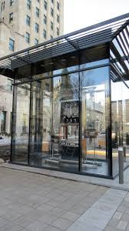
The Jura clock was a gift from Jura (a recently established francophone canton in Switzerland) to the city of Quebec, the oldest francophone community it North America.

Slide 5
Jeanne d’Arc

Slide 6
Un matin horrible pour Justin.
Justin se brossait les dents quand soudain…

Slide 7
Devoirs

Slide 8
Billet de sortie
Translate into French: Linda was pregnant when she sprained her ankle.

