Slide 1
Bonjour
mercredi, le onze décembre

Slide 2
Travail de cloche
Translate into French: Why does Marcel choose the pen which is to the right of the green calculator?

Slide 3
Bonjour
mercredi, le onze décembre
un moment de culture francophone
Nous préparons pour l’examen ultime.

Slide 4
Pourquoi tombons-nous?
Nous tombons pour apprendre comment se lever.

Slide 5
Sommes-nous prêts?
Nous sommes prêts!

Slide 6
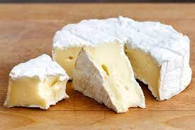
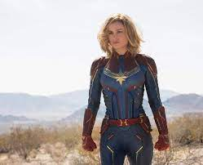
Brie is a French cheese. There are those who love this cheese so much that they name a daughter in its honor.

Slide 7
Unit 4 exam:
Friday, December 13.
The final exam, which will be cumulative, will be
Wednesday, December 18: 7:45 AM – 9:30 AM.
You are invited to study hall in this room (205A) from 2:00 – 2:45 Wednesday and Thursday.

Slide 8
Write the following times in words using twenty-four hour time.
9:30 PM _________________________________________________
10:15 AM ________________________________________________
1:58 PM _________________________________________________
1:45 AM _________________________________________________

Slide 9
Devant la cheminée

Slide 10
Devoirs

Slide 11
Billet de sortie
Translate into French: We lose weight because we eat red apples which are in front of the door.

