Slide 1
M. Gerson will be a few minutes late today. Please close the door to the room and then spend the time before he arrives speaking to each other in French.

Slide 2
Bonjour!
mercredi, le onze décembre

Slide 3
Travail de cloche
Write a sentence of at least six words, in French, about a part of a car.

Slide 4
Bonjour!
mercredi, le onze décembre

Slide 5
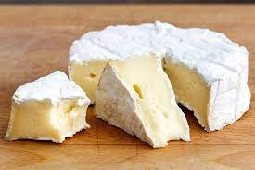
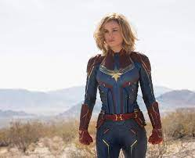
Brie is a French cheese. There are those who love this cheese so much that they name a daughter in its honor.

Slide 6
The end is near!
There will be a unit exam on Friday, December 13.
The final exam, which will be comprehensive will be Thursday, December 19 from 12:10 PM – 1:50 PM.
You are invited to study hall in this room (205A) from 2:00 – 2:45, Wednesday and Thursday.

Slide 7
p. 190

Slide 8
Louis XIII et Richelieu

Slide 9
Pictionary
p. 202

Slide 10
Devoirs

Slide 11

Billet de sortie
Write a sentence of at least six words in the passé compose which uses the reciprocal reflexive s’embrasser.

