Slide 2
Bonjour!
lundi, le six janvier
le premier jour du nouveau semestre

Slide 3
Travail de cloche
Écrivez une phrase en français.

Slide 4
Bonjour!
lundi, le six janvier
le premier jour du nouveau semestre

Slide 5
Bonjour!
un monent de culture francophone
le semestre qui commence
Nous parlons encore français.
les loisirs
Students will be able to use the verb « jouer. »
Students will be able to tell how frequently they do something.

Slide 6
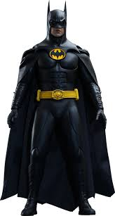
Pourquoi tombons-nous?
Nous tombons pour apprendre comment se lever.

Slide 7
Sommes-nous prêts?
Nous sommes prêts !

Slide 8
Metropolitan France is often referred to as “The Hexagon”

Slide 10
Unit exams this semester
Friday, January 31
Friday, February 28
Friday, April 4
Friday, May 2

Slide 11
HBT scores for each week will be entered into PowerSchool no later than the Sunday following that week.
The grade entered will reflect the points earned during the week. If there were days / assignments missed, the grade entered will reflect the fact that these assignments were not done, even if there was an excused absence.
If there was an excused absence, the grade in PowerSchool will be changed when the work is received. The same rules apply concerning the number of days allowed to make up work following an excused absence (vide infra), and the same rules apply about late work.
When handing in late work, you must indicate the week for which it applies as well as the date of the assignment.

Slide 12
Please check PowerSchool to be certain that you are receiving the credit you deserve for your work.
If you are confused as to why your grade is what is shown, please communicate your concerns to M. Gerson.
If you have an excused absence, you have the number of days during which you were absent plus 1 to make up the work. Thus if you were absent Monday, Tuesday, and Wednesday, then you have four days (Thursday, Friday, Monday, Tuesday) to make up the work. All work from the excused absence period is due at the start of the class on the day following the make-up period. In the example given here, make-up work is due at the start of class on Wednesday.
Make-up work must include the Travail de cloche and the Billet de sortie for each day.

Slide 13
Late work handed in by the end of ninth period on the day it is due will receive 80% of earned credit. Late work received by the end of ninth period the day after it is due will receive 70% of earned credit.
After the end of ninth period the day after an assignment is due, no credit can be received for that work unless you speak with M. Gerson and can give a valid explanation as to why the rules should be waived.

Slide 14
You must turn in you homework as soon as you enter the classroom each day. Homework not received at the start of the class period will be considered to be late.
At the start of each day, divide the Bellwork / Ticket out the door sheet in half.
The bellwork for the day will be shown at the conclusion of morning announcements.
You will have three minutes to complete the bellwork, after which time you must turn in your work.

Slide 15
The ticket out the door will be posted at the end of the class period. You will have three minutes to complete the work, after which time you must turn in your work.
If either the bellwork or the ticket out the door is not turned in when called for, it will receive no credit.

Slide 16
Dites bonjour à Justin, et puis lisez la phrase que vous avez écrit pour le travail de cloche.

Slide 17
pp. 178 - 179

Slide 18
jouer
je
tu
il / elle
nous
Vous
elles / ils

Slide 19
Andre Watts joue du piano.
Eric Clapton joue de la guitare

Slide 20
Ava joue de la flûte.

Slide 21
une flûte
Flûte! J’ai oublié d’apporter mes devoirs à classe.

Slide 22
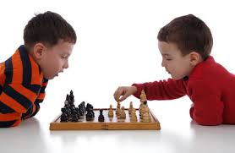
On joue aux échecs
Aimez-vous jouer aux échecs?

Slide 23
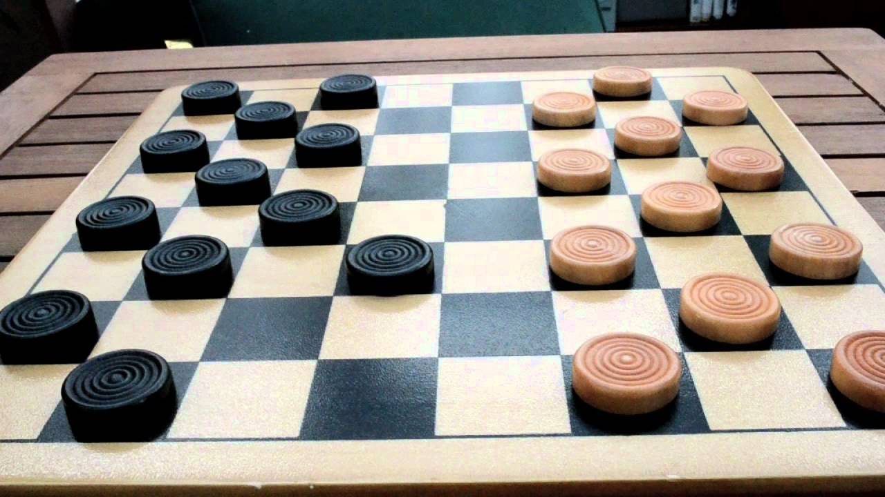
On joue aux dames (le jeu aux dames)
Aimez-vous jouer aux dames?

Slide 24
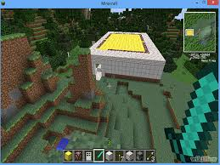
On joue à Minecraft. (Minecraft est un jeu vidéo)
Aimez-vous jouer à Minecraft?

Slide 25
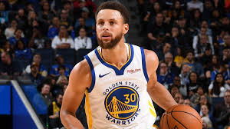
M. Curry joue souvent au basket.

Slide 26
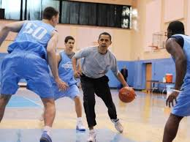
M. Obama joue parfois au basket.

Slide 27
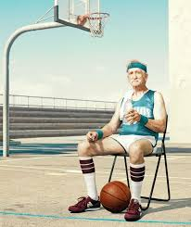
____________ joue rarement au basket.

Slide 28
Bob L’Éponge ne joue jamais au basket.

Slide 29
le foot / le football
le football américain

Slide 30
Poser la question:
Qu’est-ce que vous aimez faire souvent?
Nicole aime souvent dessiner des calmars.
parfois
rarement
Qu’est-ce que vous n’aimez jamais faire?

Slide 31
jouer de la / du
jouer à la / au
jouer aux
souvent
parfois
rarement
jamais

Slide 32
Devoirs

Slide 33
Billet de sortie
Translate into French: I like apples.

