Slide 1
Bonjour!
Français 2
mardi, le vingt et un janvier

Slide 2
Travail de cloche
Translate into French: I will write a book today.

Slide 3
Bonjour!
mardi, le vingt et un janvier

Slide 4
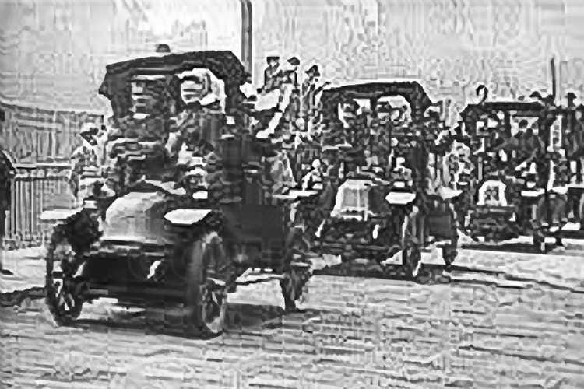
The French used taxis from Paris to take soldiers to fight at the first Battle of the Marne during World War I.

Slide 5
The world 100 years from now.

Slide 6
Devoirs

Slide 7
Billet de sortie
What will be the biggest difference between the world now and 100 years from now in your opinion?

