Slide 1


Slide 2
Travail de cloche
Quelles sont vos pensées en commençant la nouvelle année?

Slide 3
Bonjour!
lundi, le six janvier
le premier jour du nouveau semestre

Slide 4
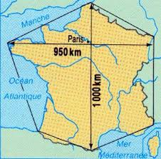
On appelle souvent la France metropolitaine “l’Hexagon”

Slide 5
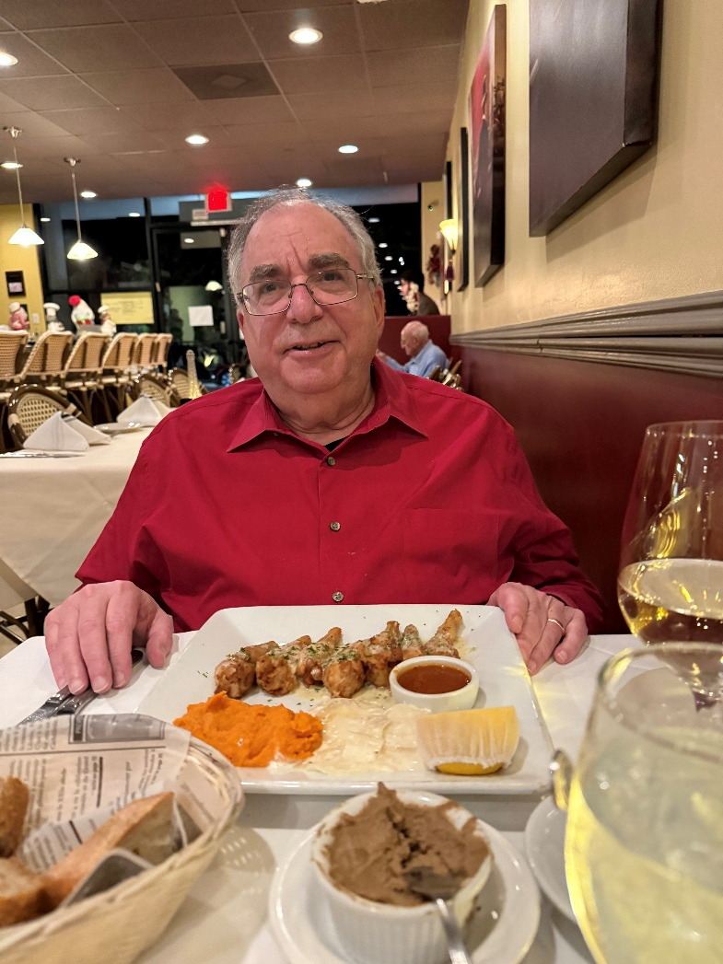

Slide 6
Unit exams for this semester
Friday, January 31
Friday, February 28
Friday, April 4
Thursday, May 15

Slide 7

notre vedette de vendredi sera…

Slide 8
Friday presentation
Choose a story which interests which you find anywhere.
Prepare a 5 – 10 minute talk, which will be completely in French, which explains
where you found the article
why you chose it
a summary of the article’s content
what you learned from it
why you wanted to share it with the class
You may use slides if you wish, or you may prepare a written summary of the article. That which you choose must cover the bullet points above and must be submitted via e-mail to M. Gerson before 7:30 AM of the Friday of your presentation.

Slide 9
HBT scores for each week will be entered into PowerSchool no later than the Sunday following that week.
The grade entered will reflect the points earned during the week. If there were days / assignments missed, the grade entered will reflect the fact that these assignments were not done, even if there was an excused absence.
If there was an excused absence, the grade in PowerSchool will be changed when the work is received. The same rules apply concerning the number of days allowed to make up work following and excused absence (vide infra), and the same rules apply about late work.
When handing in late work, you must indicate the week for which it applies as well as the date of the assignment.

Slide 10
Please check PowerSchool to be certain that you are receiving the credit you deserve for your work.
If you are confused as to why your grade is what is shown, please communicate your concerns to M. Gerson.
If you have an excused absence, you have the number of days during which you were absent plus 1 to make up the work. Thus if you were absent Monday, Tuesday, and Wednesday, then you have four days (Thursday, Friday, Monday, Tuesday) to make up the work. All work from the excused absence period is due at the start of the class on the day following the make-up period. In the example given here, make-up work is due at the start of class on Wednesday.
Make-up work must include the Travail de cloche and the Billet de sortie for each day.

Slide 11
Late work handed in by the end of ninth period on the day it is due will receive 80% of earned credit. Late work received by the end of ninth period the day after it is due will receive 70% of earned credit.
After the end of ninth period the day after an assignment is due, no credit can be received for that work unless you speak with M. Gerson and can give a valid explanation as to why the rules should be waived.

Slide 12
You must turn in you homework as soon as you enter the classroom each day. Homework not received at the start of the class period will be considered to be late.
At the start of each day, divide the Bellwork / Ticket out the door sheet in half.
The bellwork for the day will be shown at the conclusion of the playing of the Radetzky March
You will have three minutes to complete the bellwork, after which time you must turn in your work.

Slide 13
The ticket out the door will be posted at the end of the class period. You will have three minutes to complete the work, after which time you must turn in your work.
If either the bellwork or the ticket out the door is not turned in when called for, it will receive no credit.

Slide 14

Les Misérables

Slide 15
À la volonté du peuple.

Slide 16
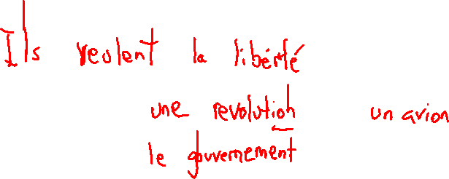
Billet de sortie
Que veulent faire les gens qui chantent la chanson “À la volonté du peuple”?

