Slide 1
mercredi le douze février

Slide 2
Write a sentence which uses the relative pronoun dont.

Slide 3
mercredi le douze février

Slide 4
Abraham Lincoln, sixteenth president of the United States, was born on this date in 1809
"As I would not be a slave, so I would not be a master. This expresses my idea of democracy. Whatever differs from this, to the extent of the difference, is no democracy."

Slide 5
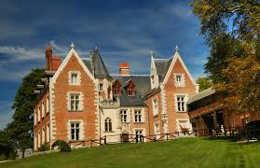
Le Chateau Clos Lucé, in the French town of Amboise, was the home of Léonardo da Vinci during the final three years of his life. The chateau was also the boyhood home of his patron King François Ier

Slide 6
That is the dog that jumps through hoops. (hoop = cerceau)
That is the hoop that Fido likes.
That was the the day when the music died.
Buddy Holly is the singer I am talking about.

Slide 7
…et maintenant, quelque chose complètement différente!

Slide 9
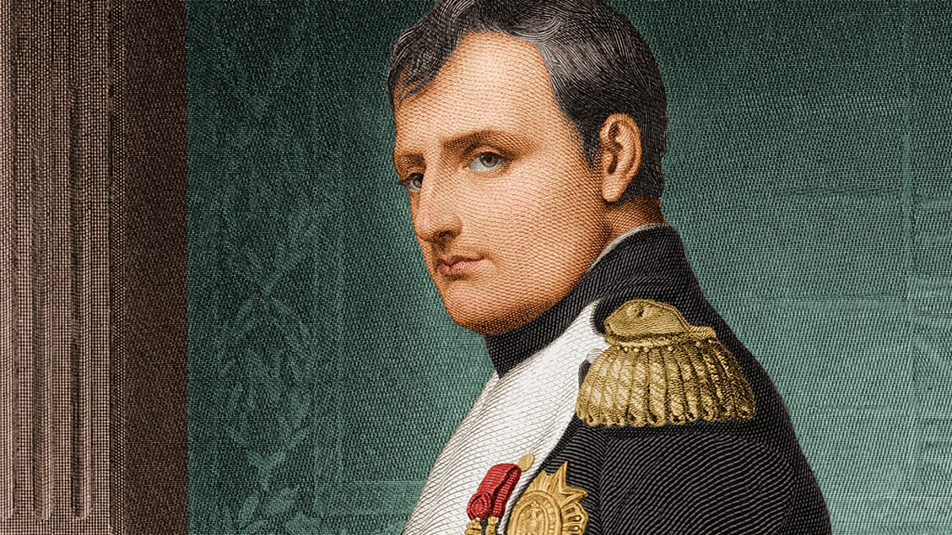

Slide 10
Vous êtes responsables au Roi Burger à Sainte-Hélène.
Vous avez passé un entretien avec Napoleon Dynamite et avec Napoléon Bonaparte pour le poste de cuisiner de burgers.
Vous discutez si vous voulez offrir le poste à M. Dynamite ou à M. Bonaparte.
Vous donnez les avantages et les inconvénients des deux candidats.
Enfin vous prenez une décision.

Slide 12
Devoirs

Slide 13
Billet de sortie
Traduisez en français: Napoléon Bonaparte is the person about whom I speak.

