Slide 1
Bonjour!
mercredi, le dix-neuf février

Slide 2
Travail de cloche
Rewrite the following sentence replacing the indirect object with an appropriate pronoun.
Je donne trois souris vertes à Marie et à Clothilde.

Slide 3
Bonjour!
mercredi, le dix-neuf février
un moment de culture francophone
révision

Slide 4
Pourquoi tombons-nous?
Nous tombons pour apprendre comment se lever.

Slide 5
Sommes-nous prêts?
Nous sommes prêts !

Slide 6
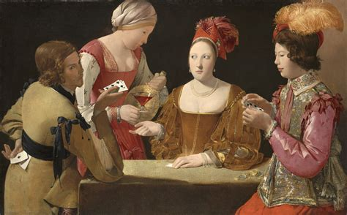
Georges de la Tour was a painter who was born in Lorraine in 1593 and whose work can be found in museums in Paris and in Fort Worth, Texas.

Slide 7
demonstrative adjectives
the passé compose with avoir
indirect object pronouns
regular and irregular RE verbs

Slide 8
indirect object pronouns
1st person singular
2nd person singular
3rd person singular
1st person plural
2nd person plural
3rd person plural

Slide 9
COI pronoun subject pronoun
me elles
te ils
lui vous
nous je
vous nous
leur tu

Slide 10
rendre
se rendre
rendre visite
rendez-vous

Slide 11
aérobique alphabet

Slide 12
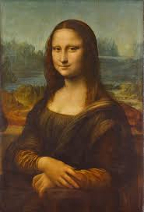
la musique

Slide 14
This dress is green.
I gave these red shoes to him.
Marie and Jacques carried down the ice cream to the basement.
I wait for Madeleine who sings.
We gave them this computer.

Slide 15
Tuesday, I drove a blue car when I took Justin to Denver.
Yesterday, Marie put the cookies on the table.
Louis and Bertrand took three cakes to the party.
I smile at the two mice who laugh at the candy.
This black sweater is expensive.

Slide 16
Devoirs

Slide 17
Billet de sortie
Translate into French: I sold six blue socks to Elaine when I visited Celeste in Montreal.
Notes:
é

