Slide 1
Bonjour!
jeudi, le vingt février

Slide 2
Travail de cloche
Write a sentence which uses the relative pronoun “que.”

Slide 3
Bonjour!
mercredi, le vingt février

Slide 4
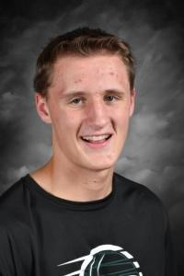
Bon anniversaire
Bon anniversaire
Bon anniversaire
Bon anniversaire cher David
Bon anniversaire

Slide 5
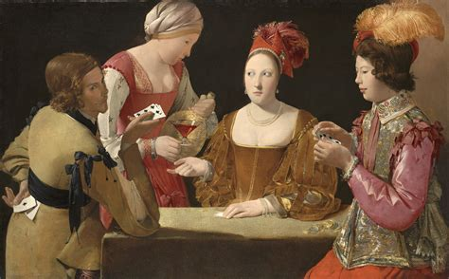
Georges de la Tour was a painter who was born in Lorraine in 1593 and whose work can be found in museums in Paris and in Fort Worth, Texas.

Slide 6
les devoirs

Slide 7
Write a sentence with each of the following.
lequel _________________________________________________________
lesquelles _____________________________________________________
auquel_________________________________________________________
de laquelle_____________________________________________________
à laquelle______________________________________________________
desquels______________________________________________________

Slide 8
As soon as I finish my homework, I will eat dinner at Nick’s.
If I finish my homework before 7 PM, I will eat dinner at Nick’s
When I finish my homework, we will go to dinner at Nick’s.

Slide 9
If you study, you succeed.
When the bell rings we stop talking.
As soon as the teacher says goodbye we leave the room.

Slide 10
aérobique alphabet

Slide 11
la musique

Slide 12
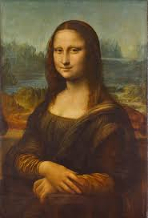
la musique

Slide 14
un emploi possible
Justin a décidé qu’il ne voulait plus être rock star.

Slide 15
Devoirs

Slide 16
Billet de sortie
Quelle était la profession dont vous rêviez quand vous aviez six ans?

