Slide 1
Bonjour!
jeudi, le six février

Slide 2
Travail de cloche
Quelle est la chose que Fernand et Danglars partagent?

Slide 3
Bonjour!
jeudi, le six février

Slide 4
Who won the Nobel Prize this year?
He is the man who won the Nobel Prize.
Everyone is talking about Napoléon Bonaparte.
.
Napoléon Bonaparte is the general everyone is talking about.
What makes Carnegie Hall special?
Carnegie Hall is the place where the best music is performed.
Comment se rend-on à La Salle de Carnegie?

Slide 5
What would you like for dinner?
Alberich stole the ring that Mime made.
When Anne arrives we will start the music.
Anne turned sixteen years old the day when the war started.

Slide 6
aérobique alphabet

Slide 7
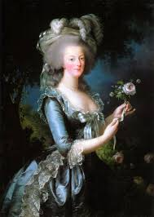
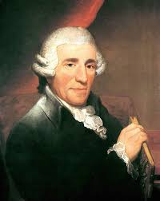

Slide 8
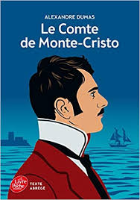

Slide 9
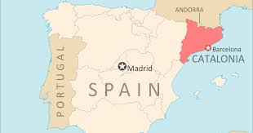

Slide 10
Devoirs

Slide 11
Billet de sortie
Danglars, pourquoi jete-t-il sa lettre au coin de la taverne?

