Slide 1
Bonjour!
mardi, le onze février

Slide 2
Travail de cloche
Quelle est la prison à laquelle Edmond est transporté?

Slide 3
Bonjour!
mardi, le onze février

Slide 4
Andre Makine, who was born in Siberia, was raised by a French grandmother. All of his literary works have been written in French. He has been a member of L’Académie Française since 2016.

Slide 6
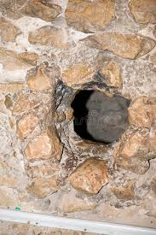

Slide 7
un savant

Slide 8
Le Trésor de l’Abbé Faria

Slide 9
Billet de sortie
Quelle est une autre prison que le chateau d’If?

