Slide 1
vendredi, le onze avril

Slide 2
Travail de cloche
Translate into French: Whales make me happy, so they can make me give them a lot of krill.

Slide 3
vendredi, le onze avril

Slide 4
Vendredi, vendredi
Rah, rah, rah!
Vendredi, Vendredi
On y va!

Slide 5
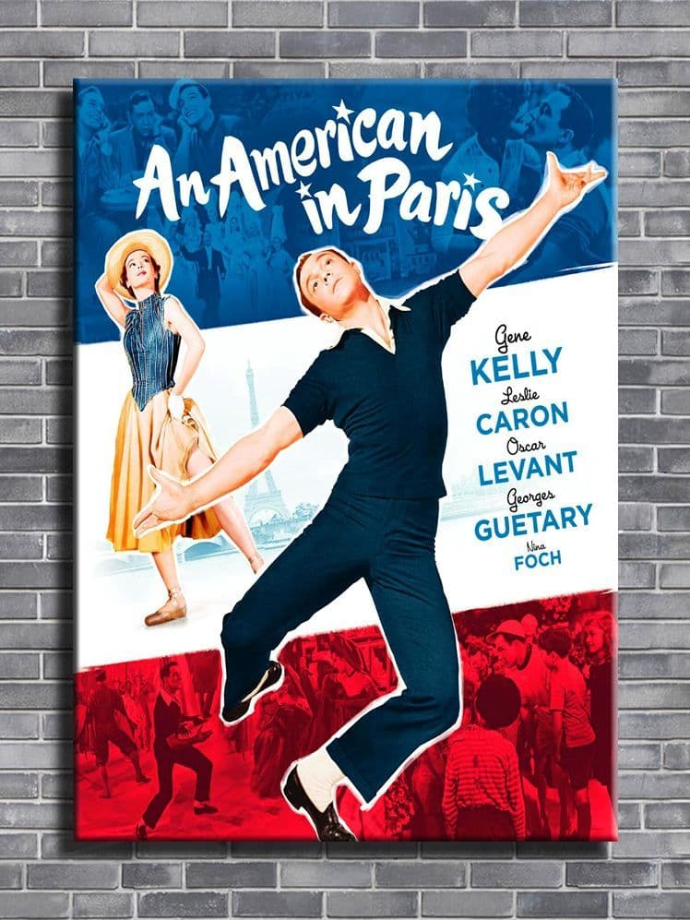
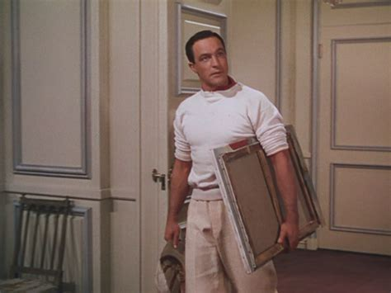
Gene Kelly was the star of the film An American in Paris. He lived in Paris for many years and spoke French fluently.

Slide 6
…et maintant, notre vedette du jour…

Slide 7
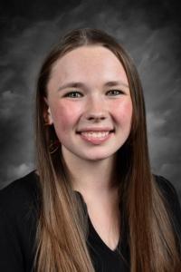

Slide 10
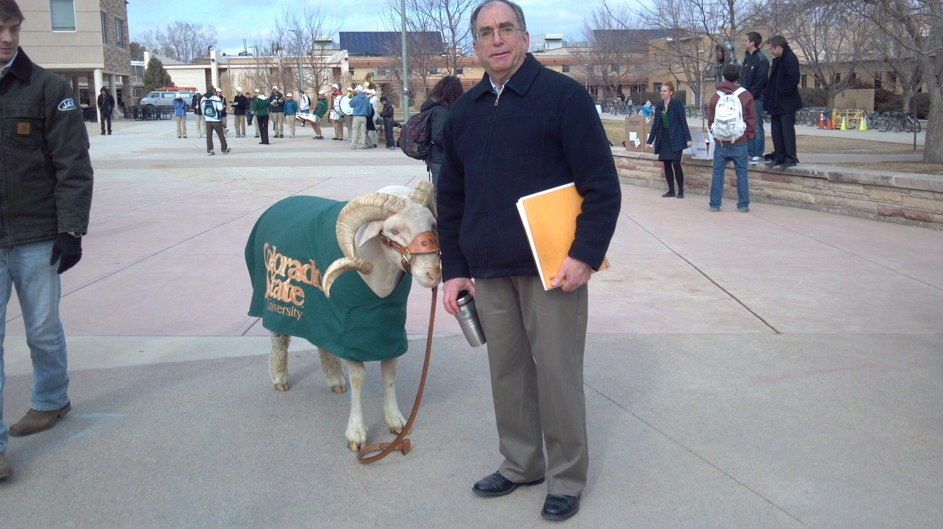
Qui est le bélier le mieux connu à Fort Collins?

Slide 12
Devoirs

Slide 13
Billet de sortie
Translate into French: All of the rams at CSU are proud, even though their school wasted a lot of money to have Canvas Stadium built.

